Slide 1
CS 211 Computer Architecture Lecture 14: Pointer Fundamentals, Memory Map - Concept
Ravi Mittal
ravi.mittal@iitgoa.ac.in
Indian Institute of Technology, Goa

Slide 2
Acknowledgements
Class Presentation, CS61C, C: Introduction, Pointers, University of Berkeley, Nick Riasanovsky, Fall 2019 http://inst.eecs.Berkeley.edu/~cs61c
Computer Organization and Design, The Hardware Software Interface, RISC-V edition, Patterson and Hennessey
Digital Design and Computer Architecture: RISC-V Edition, Harris & Harris Elsevier – Presentation
Book, All of Programming, Andrew Hilton, Anne Bracy

Slide 3
In today’s class we will study
HLL Program → Executables
A bit about Pointers
Program’s Memory
Instruction Addresses in RISC-V

Slide 4
HLL Program → Executable

Slide 5
How to compile and run a program?
Ref: Harris and Harris Book: Digital Design and Computer Architecture: RISC-V Edition

Slide 6
Bit about Pointers

Slide 7
Address vs. Value
Consider memory to be a single huge array
Each cell/entry of the array has an address
Each cell also stores some value
Don’t confuse the address referring to a memory location with the value stored there
101 102 103 104 105 ...
...
...
23
42
Ref: Course 61C, Nick Riasanovsky , Univ of California, Berkeley

Slide 8
Pointers
A pointer is a variable that contains an address
An address refers to a particular memory location, usually also associated with a variable name
Location
(address)
Data
...
101 102 103 104 105 ...
...
23
42
104
Variable names
x
y
p
Ref: Course 61C, Nick Riasanovsky , Univ of California, Berkeley
Notes:
Create a pointer p and have it point to the variable x, which is at address 104.

Slide 9
Pointer Syntax
int *x;
Declare variable x as the address of an int
x = &y;
Assigns address of y to x
& called the “address operator” in this context
z = *x;
Assigns the value at address in x to z
* called the “dereference operator” in this context
Ref: Course 61C, Nick Riasanovsky , Univ of California, Berkeley

Slide 10
Pointer Example
int *p;
int x; int y; x=3; y=4;
p = &x;
*p = 5;
y = *p;
p
?
x
?
y
?
Declare
Assign vals
Assign ref
Dereference (1)
Dereference (2)
p
?
x
3
y
4
p
x
3
y
4
p
x
5
y
4
p
x
5
y
5
Ref: Course 61C, Nick Riasanovsky , Univ of California, Berkeley

Slide 11
Pointer Types
Pointer is not a type. It is a type constructor
Pointers are used to point to one kind of data (int, char, a struct, etc.)
Pointers to pointers? Oh yes! (e.g. int **pp)
Exception is the type void *, which can point to anything (generic pointer)
Use sparingly to help avoid program bugs and other bad things!
Ref: Course 61C, Nick Riasanovsky , Univ of California, Berkeley

Slide 12
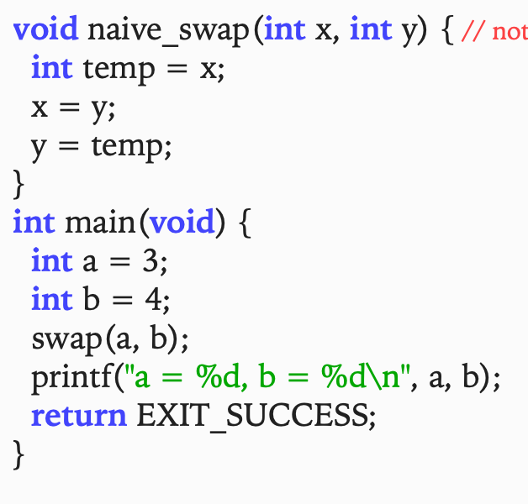
Swap Function: Does it work?

Slide 13
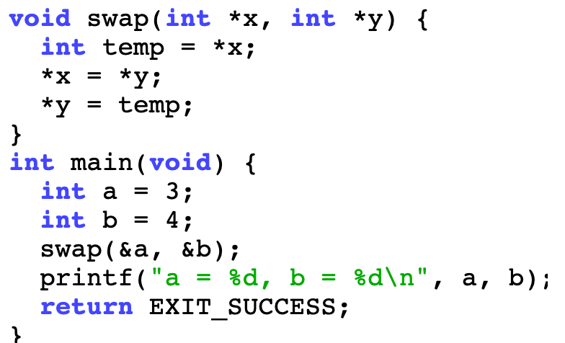
Modified Swap function

Slide 14
Program’s Memory

Slide 15
Address Space
32 bit machine
Memory space begins at 0x00000000 and ends at 0xFFFFFFFF
Every program has this address space at it’s disposal
Can a program use this address space in anyway it wants?
NO
It uses a convention – how a program uses this range of addresses
What are various components of a program ?
Code
Local Data
Global Variable (Data)
What else? Malloc?

Slide 16
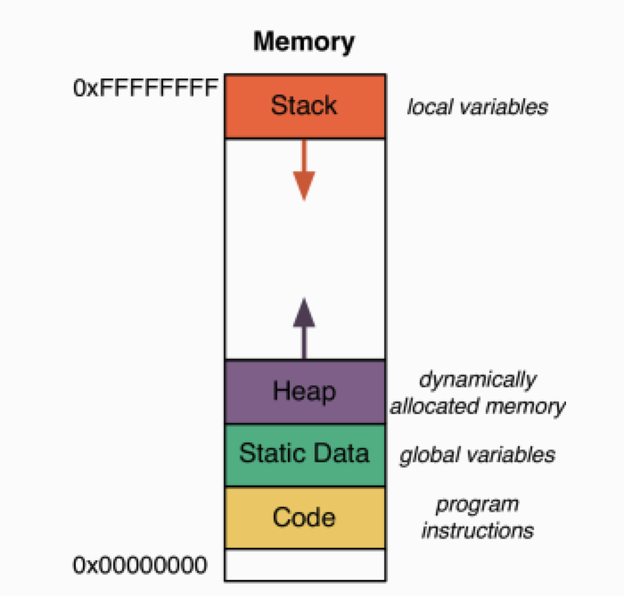
High level depiction of a Program’s Memory
For a processor

Slide 17
Program Code
Processor can run only executable code – Object code
Machine Instructions
Consist of zeros and ones
Object code program lives in the code portion of the memory (also called Text portion)

Slide 18
Static Data
This area contains Global Variable
Global variables can be accessed from any part of the program
These variables live for entire life (run) of the program
Note that local variable live only limited life till the function is executing. After the exit from the function, local variables no longer exist
Static (global) variables are placed in the green portion

Slide 19
The Heap
It stores dynamically allocated data
Dynamic memory allocation
A program can request a specific amount of memory at run time
Use of malloc
This memory is not on stack – and hence it must be freed by programmer
Heap size changes during program execution
Memory Allocation Library (OS)
Manages space on the Heap

Slide 20
The Stack
It stores the local variables declared by each function
The stack is divided into stack frames
A stack frame becomes alive when the function is called and becomes dead when function execution completes

Slide 21
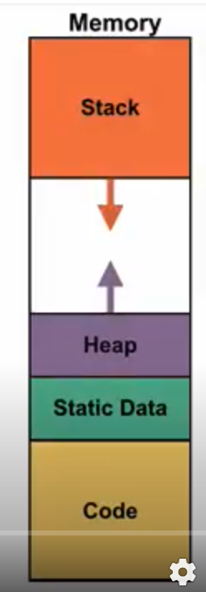
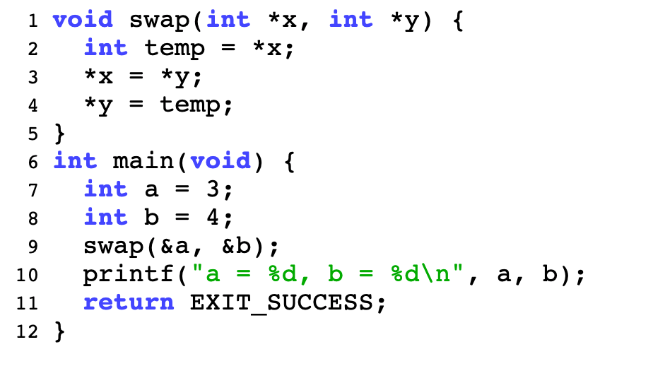
Example: Swap Function
Note that this program doesn’t have global variables and
dynamic data - malloc

Slide 22
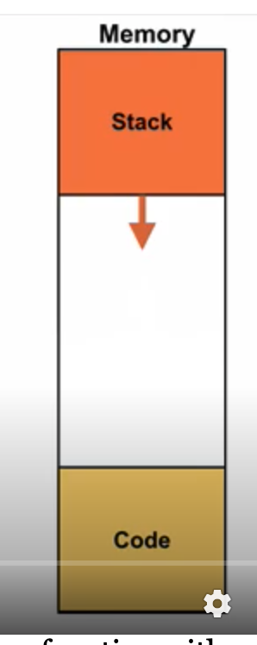
Example: Swap Function

Slide 23
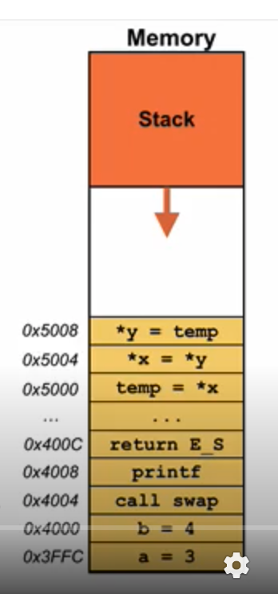
Example: Swap Function
Actually code will contain machine executable code

Slide 24
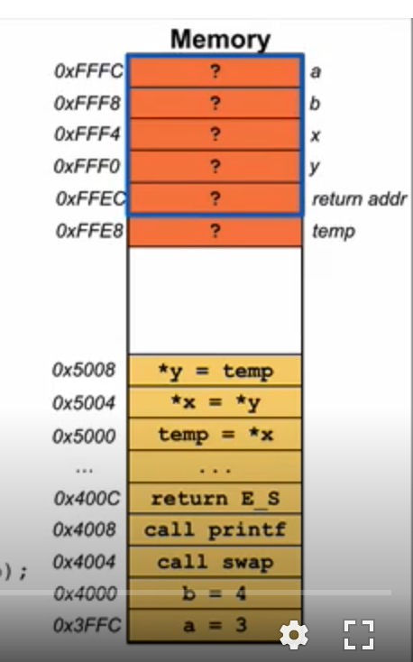
Example: Swap Function
Stack Frame for main
Stack Frame for swap

Slide 25
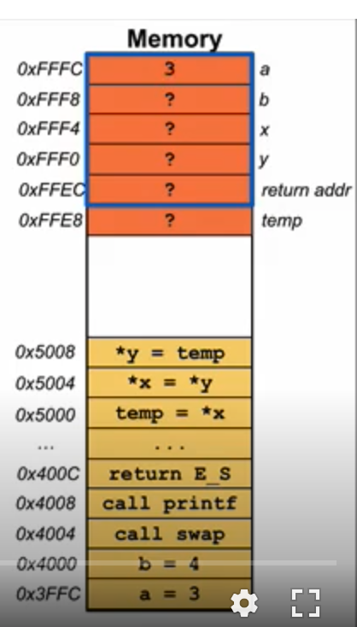
Example: Swap Function

Slide 26
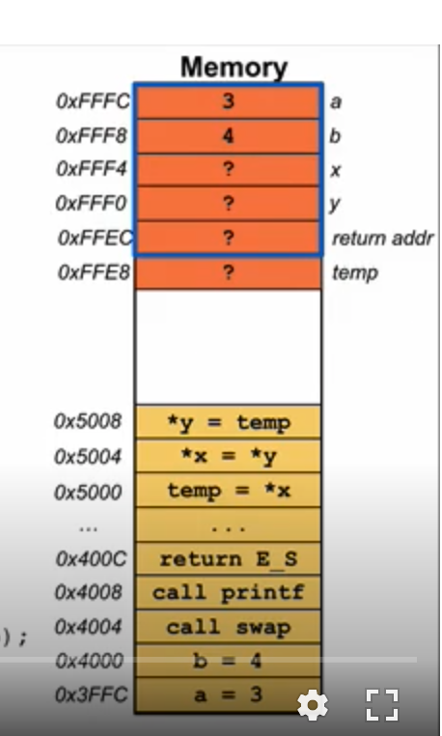
Example: Swap Function

Slide 27
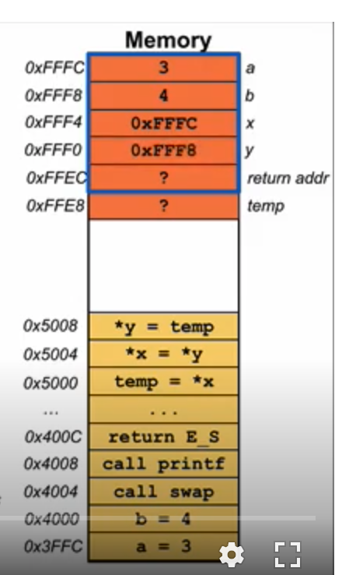
Example: Swap Function

Slide 28
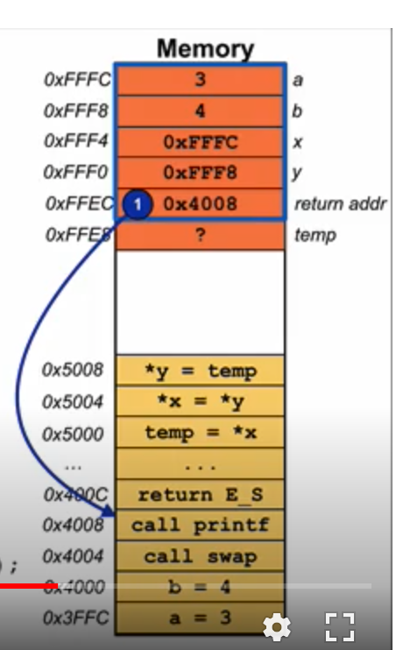
Example: Swap Function
Save return address

Slide 29
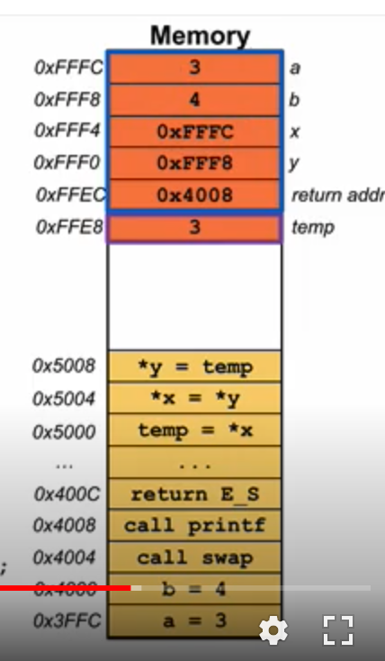
Example: Swap Function

Slide 30
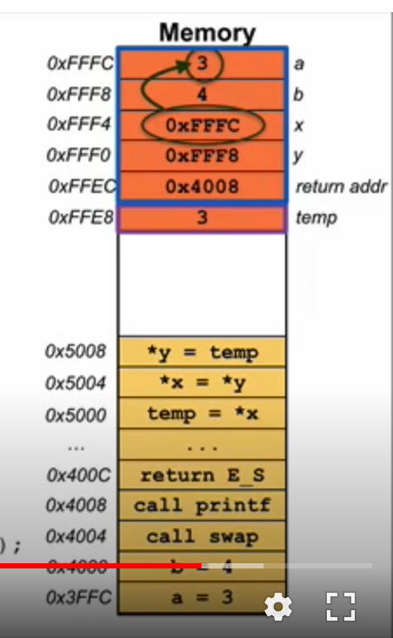
Example: Swap Function

Slide 31
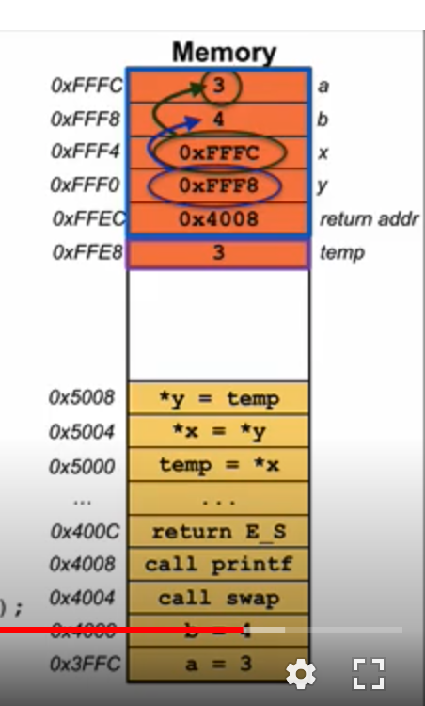
Example: Swap Function

Slide 32
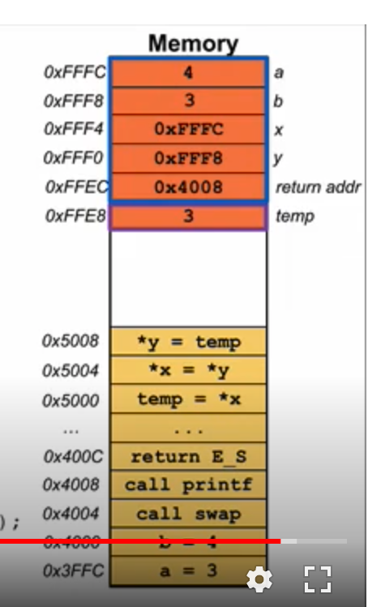
Example: Swap Function

Slide 33
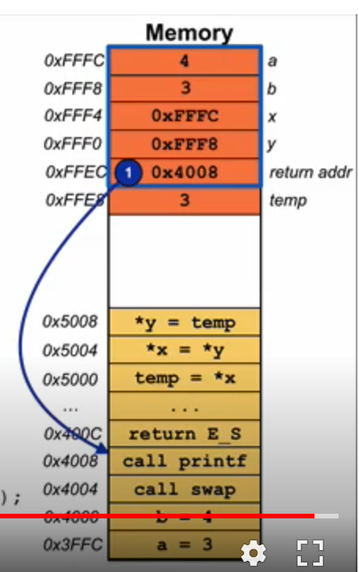
Example: Swap Function

Slide 34
Instruction Addresses in RISC-V

Slide 35
Instruction Addresses
~ FFFF FFFF_{hex}
stack
Instructions are stored as data in memory and have addresses!
Recall: Code section
Labels get converted to instruction addresses
More on this later this week
The PC tracks where in memory the current instruction is
heap
static data
code
~ 0_{hex}

Slide 36
Backup

